Slide 1
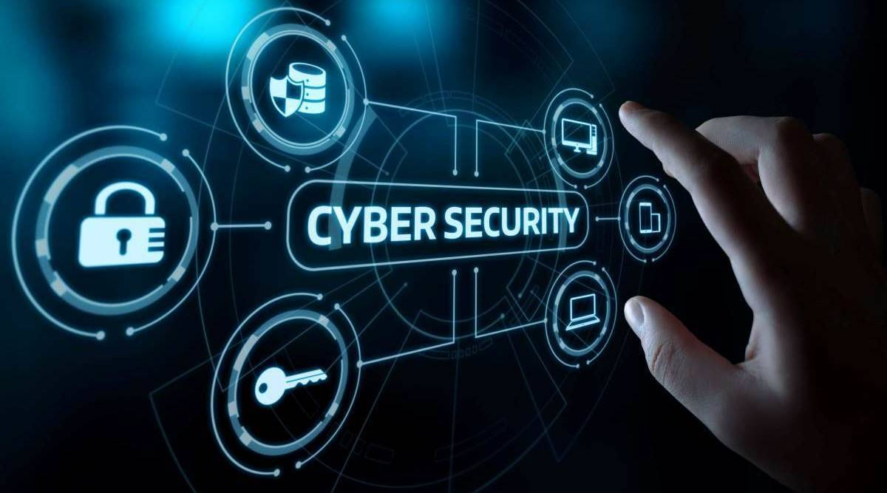
Cybersecurity Mitigation Methods

Slide 2
Security baseline

Slide 3
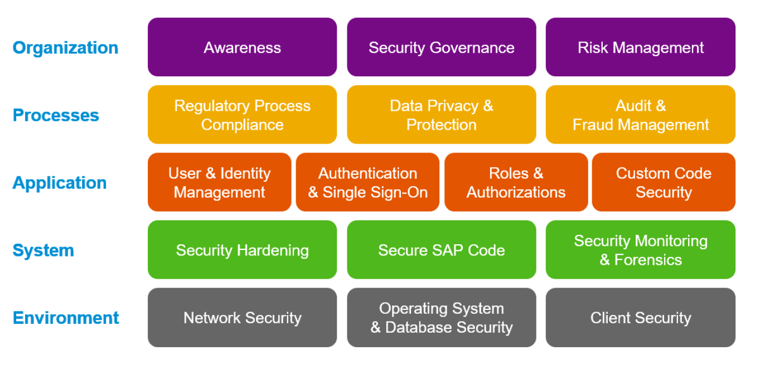
Security baseline
A preliminary assessment of a newly implemented system
Serves as a starting point to measure changes in configurations and improvements in the system
Periodic risk assessments will provide current state & effectiveness
Security baseline is used in risk assessment procedures

Slide 4
The Threats and Monitoring Plans
Security Monitoring
Computer Virus Controls
Microcomputer Security
License management
Other security
Physical and Environmental Security
Backup and Recovery

Slide 5
Security Monitoring Plan
Purpose is to identify suspected access violations and attempted system intrusions. A sample plan is:
Daily review of remote access log-ins to identify failed access attempts
Review of system access logs for access to systems during non-work hours
Review of traffic on external gateways
Review of access to application system utilities and privileged user activities
Review of access to sensitive files or data

Slide 6
Computer Virus Controls
An effective plan should include:
Downloading current definitions from the appropriate sources on a timely basis
Test virus software before distribution
Distribute and upload current definitions to all platforms (servers, mail servers, firewalls, and workstations)
Validate that distribution of software and definition files is effective
Ensure compliance with all anti-virus software procedures
Assess the communication mechanism between administrators and users on potential viruses and the reporting of suspected viruses

Slide 7
Microcomputer Security
License management:
Monitoring licenses registered versus licenses used
Inventorying PC software
Developing and distributing approved software lists
Developing software usage policies

Slide 8
Microcomputer Security
Other Areas to Be Monitored:
Prevent the use of unauthorized software
Provided training to all PC users
Ensure physical and logical security of PCs used for critical business operations
Ensure PC software development adherence to approved software development and maintenance methodologies
Provide adequate documentation of PC applications to users
Ensure the integrity of all data, applications, and information processes on the PC
Provide for backup and contingency plans for PC hardware, software, and peripherals

Slide 9
Physical and Environmental Security
A physical security plan should check the use of:
Cipher or key pad locks
Fencing
Guards
Monitoring devices
Maintaining authorized personnel access lists
Limiting access to only essential operations personnel
Maintaining sign-in logs
Badges

Slide 10
Physical and Environmental Security
An environmental security plan should check/provide for:
Backup power (UPS)
Air conditioning
Fire suppression devices (fire extinguishers, halon, other)
Fire detection devices (sensors)
Heat detection devices
Business continuity plans
Alternate processing facilities
Disaster recovery plans
System and data backups

Slide 11
Backup and Recovery
Backups are critical
Backups must be performed so that system, program, or information loss or damage can be efficiently restored
Backups should be stored away from the processing facilities
Tape management techniques need review

Slide 12
Checking Third-party access
Check for:
Who, when and how third-party vendors obtain, transport, and store those critical data
Ensure accountability is established for transfer, transport, and storage
Review third-party’s procedures periodically
Ensure that vendors are suitably placed to perform disaster recovery
Ensure that they sign non-disclosure agreements as they have access to critical business data
If tapes are internally managed, then ensure proper labeling procedure

Slide 13
Network Assessment Checklist
Obtain an understanding of the network architecture
Review network diagrams and documentation
Interview data network administrators
Interview network device administrators
Review standards relating to networked systems
Review planned migration to new technologies
Review network software inventory
Review network hardware inventory
Identify business functions utilizing the network

Slide 14
Network Assessment…
Obtain an understanding of network management
Identify network management tools and other utility software used in managing network
Identify how network management tools are used
Identify the devices managed through network
Identify plans or changes to network managers

Slide 15
Network Assessment…
Obtain an understanding of network security administration:
Identify policies, procedures, standards, and guidelines for network security administration
Identify responsibilities for network security administration
Identify monitoring capabilities and reports used in network security administration

Slide 16
Network assessment…
Obtain an understanding of outage/threat response capabilities:
Identify tools and approaches to reducing risks
Identify responsibility for emergency response
Identify tools/strategies for responding to emergency conditions
Identify threat incidents and priorities

Slide 17
Operating System Security Assessment
Checklist includes
Security policies
System configuration
System change control
Domains and trust relationships
Networking
Remote access
Physical access
Log-on and log-off controls

Slide 18
Operating System Security Assessment…
User management
Group management
Password management
Directory and file system security
System privileges and utilities
Maintenance and operations
Logging
Backup and recovery
Security administration

Slide 19
Things that can make IS difficult
Lack of project sponsor and executive management support
Security implementations, projects, and architectures need to be clearly understood by management and appropriate support should be provided
Executive Management’s lack of understanding of realistic risk
Less time and effort appropriated as a result
Security audits should be used in a timely manner
Lack of resources
Check listing and assessing is a time/resource consuming process

Slide 20
Things that can make IS difficult
Impact of mergers and acquisitions on disparate systems
Different tools running on different platforms may need to interact together
Different security practices can cause problems, 1+1 < 2 in security!!
A detailed audit takes time and often systems start failing in the new environment before the audit finishes
Independent operations throughout business units
Different units of the same company can work autonomously
Interoperability can create security problems

Slide 21
Things that can make IS difficult
Discord between mainframe versus distributed computing cultures
Mainframes provided central point of security
Now security is distributed all over the place
Fostering trust in the organization
To foster trust organizations tend to loosen security requirements

Slide 22
Things that can make IS difficult
Third-party and remote network management
Outsourcing of network operations
Following points can be used to bind the third-party
Requirement to sign and accept internal confidentiality agreements
Accepting and abiding by the contracting organization’s security policies and standards
Validation and authentication of users
Intrusion detection requirements, tools etc
…

Slide 23
Thank You

